Slide 1

Physics 1
Voronkov Vladimir Vasilyevich

Slide 2
Lecture 2
SUBJECTS:
Forces in mechanics
Dynamics
Newton’s laws

Slide 3
Dynamics
Dynamics studies the cause of changes in motion.
Forces act on an object and influences its motion.

Slide 4
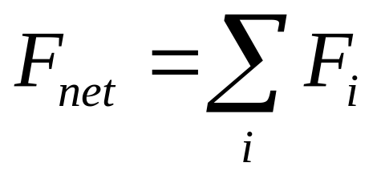
Force
A force is a vector, so that it has:
  a direction
  a magnitude
Forces are additive, which means that when several forces act together, the subsequent motion of the object acted on is the same as if a single force equal to the vector sum of the individual forces were acting. That single force is the net force:

Slide 5
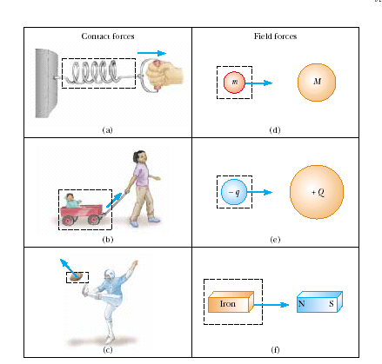

Slide 6
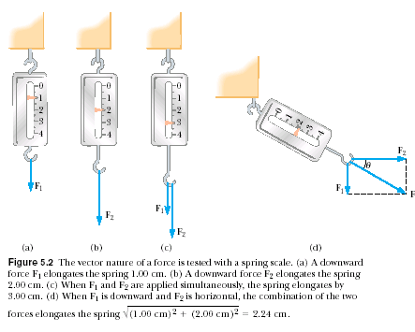

Slide 7
Three fundamental forces
Gravitational force.
Electroweak force: a united force of electromagnetism and the weak force, responsible mainly for some types of radioactive processes in nuclei and.
Strong force – a nuclear force.
The electromagnetic force is responsible for most of the secondary forces: tension, friction, pull and push forces, spring forces.

Slide 8
Newton’s first law of motion two equivalent variants:
1. When there is no net force acting on an object, that object maintains its motion with a constant velocity.
2. If an object does not interact with other objects, it is possible to identify a reference frame in which the object has zero acceleration.

Slide 9
Such a reference frame is called an inertial frame of reference.
Newton’s first law does not say what happens to an object with zero net force; it says what happens in the absence of a force. This is a subtle but important difference that allows us to define force as that which causes a change in the motion. The description of an object under the effect of forces is covered by Newton’s second law.

Slide 10
Newton’s second law of motion
When viewed from an inertial reference frame, the acceleration of an object is directly proportional to the net force acting on it and inversely proportional to its mass.

Slide 11
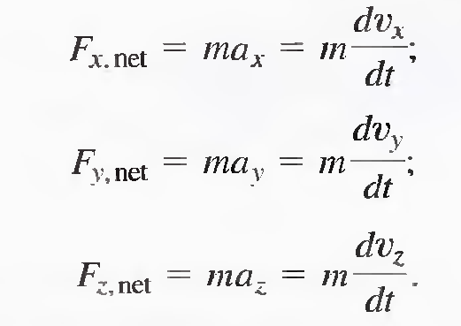
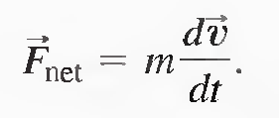
⬄

Slide 12

Newton’s third law of motion
When a force due to object B acts on object A, then an equal and opposite
force due to object A acts on object B.

Slide 13
Mass and Weight
Mass is that property of an object that specifies how much resistance an object exhibits to changes in its velocity. The greater the mass of an object, the less that object accelerates under the action of a given applied force.

Slide 14
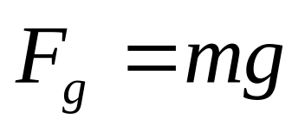
The attractive force exerted by the Earth on an object is called the gravitational force F_{g.} This force is directed toward the center of the Earth, and its magnitude is called the weight of the object.
Thus, the weight of an object, being defined as the magnitude of F_{g} , is equal to mg. Because it depends on g, weight varies with geographic location. Because it decreases with increasing distance from the center of the Earth, objects weigh less at higher altitudes than at sea level.

Slide 15
Mass and weight are two different quantities
The weight of an object is equal to the magnitude of the gravitational force exerted on the object and varies with location. For example, a person who weighs 180 lb on the Earth weighs only about 30 lb on the Moon. On the other hand, the mass of an object is the same ever everywhere: an object having a mass of 2 kg on the Earth also has a mass of 2 kg on the Moon.

Slide 16
Action – Reaction forces
Forces always occur in pairs, or that a single isolated force cannot exist. The force that object 1 exerts on object 2 may be called the action force and the force of object 2 on object 1 the reaction force. In reality, either force can be labeled the action or reaction force. The action force is equal in magnitude to the reaction force and opposite in direction. In all cases, the action and reaction forces act on different objects and must be of the same type.

Slide 17
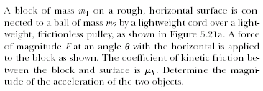
Acceleration of Two Connected Objects When Friction Is Present

Slide 18
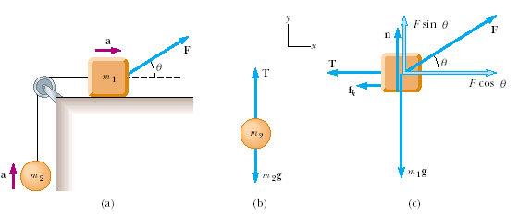

Slide 19
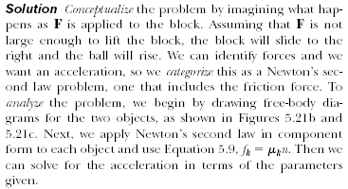

Slide 20
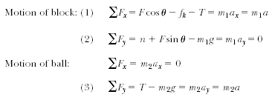
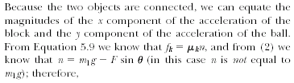

Slide 21
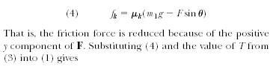
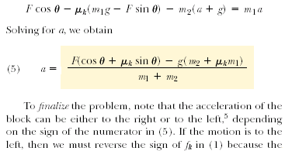

Slide 22


Slide 23
Units in SI
Force F N=kg*m/s²
Acceleration a,g m/s²

